Slide 1

Fireproof Your Computer from Jenny Bryan
R Projects and here::here()
Kat Hoffman
R-Ladies NYC Lightning Talk
June 19, 2019

Slide 2

“If the first line of your #rstats script is setwd("C:\Users\jenny\path\that\only\I\have"),
I will come into your lab and
SET YOUR COMPUTER ON FIRE.”
-Jenny Bryan

Slide 3

R Project: a shortcut to open RStudio and work on an individual project

Slide 4
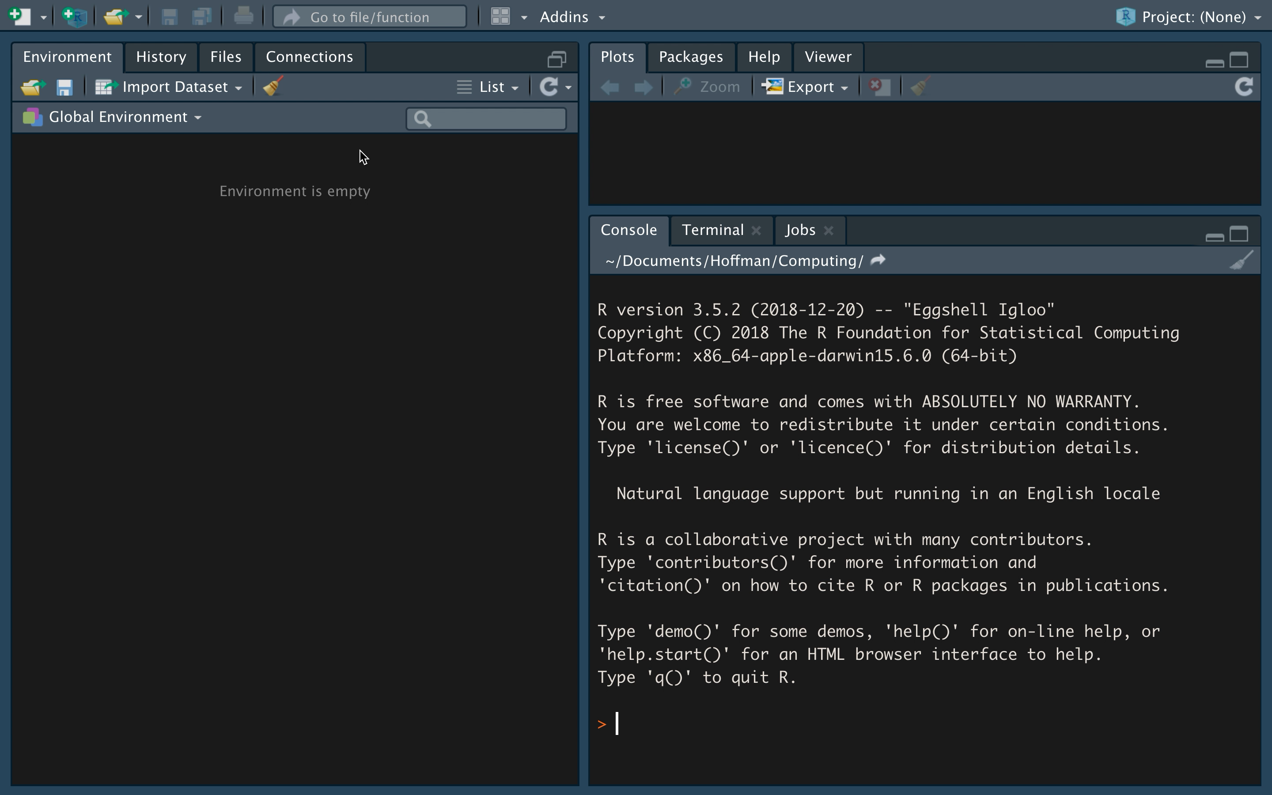
Make an R Project – it’s easy!

Slide 5
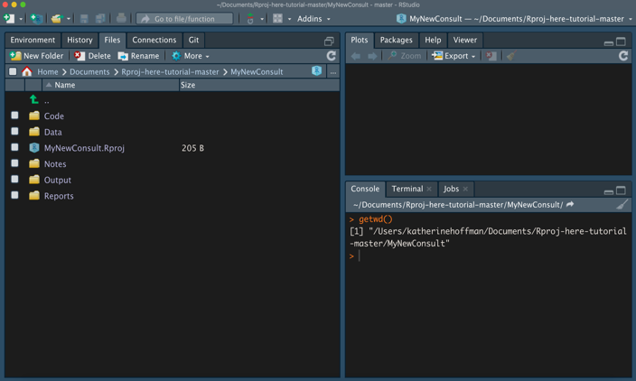
Check your working directory

Slide 6
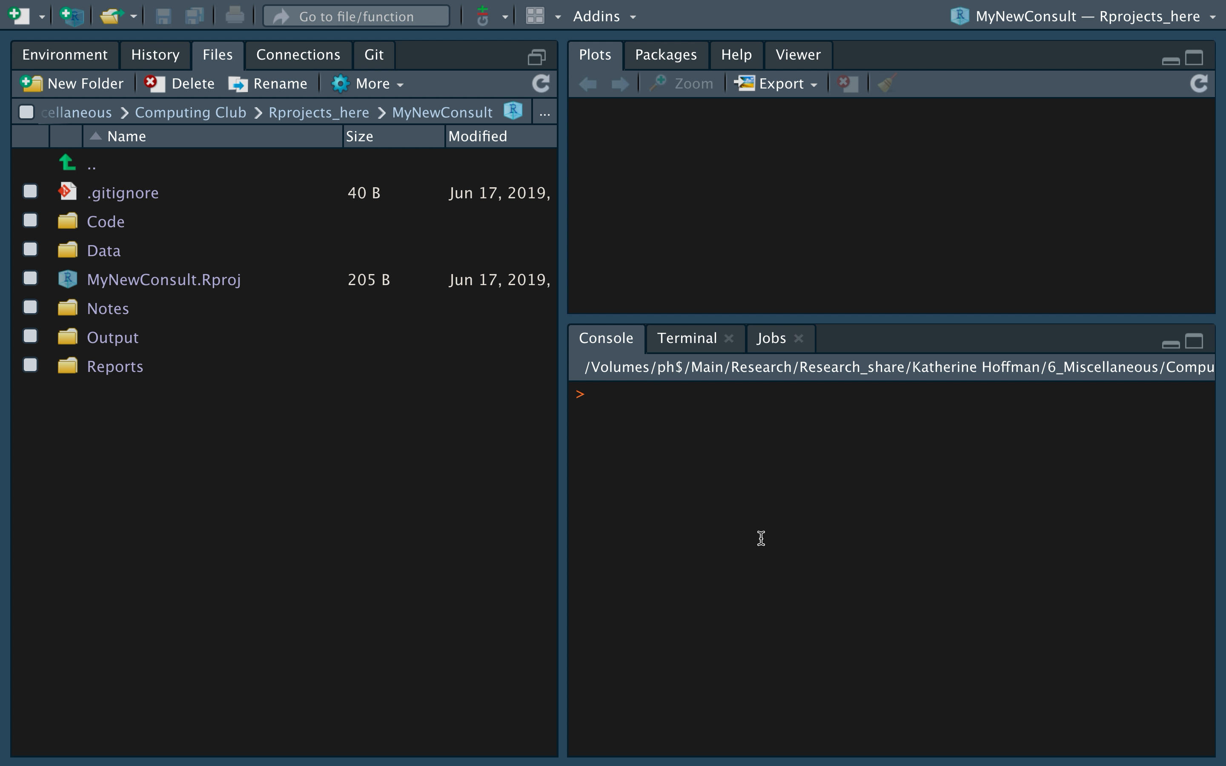
Read and write files

Slide 7

The Beauty of R Projects
Move the folder containing your R Project anywhere
Version control with Git directly in RStudio
Initialize a packrat library
Source: giphy.com

Slide 8

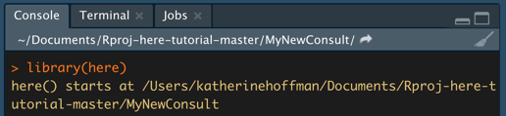
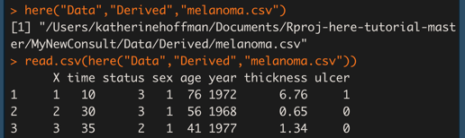
here::here() reminds all your read/write code to work with the R Project’s root directory
Drawing by Allison Horst @allison_horst

Slide 9
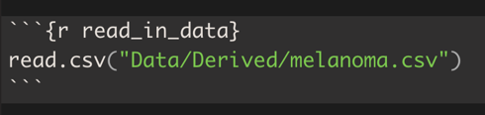
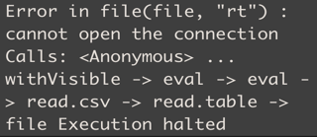
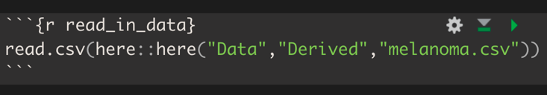
here::here() is especially helpful when using subfolders + Rmarkdown
!

Slide 10
Takeaways:
Use R Projects!
Add here::here() around all your read/write files

Slide 11
Practice
Resources
Interactive codes to try:
https://github.com/kathoffman/Rproj-here-tutorial
Jenny Bryan’s Project-Oriented workflow tutorial: https://www.tidyverse.org/articles/2017/12/workflow-vs-script/
Jenny Bryan’s here::here() explanation: https://github.com/jennybc/here_here/blob/master/README.md
Malcolm Barrett on why you should use here() in addition to RProjects: https://malco.io/2018/11/05/why-should-i-use-the-here-package/

